Slide 1
Creating a Strategic Plan at your Catholic School
Diocesan School Board In-Service
Saturday, September 22, 2018

Slide 2
What is a Strategic Plan?
Where are we now?
Where are we going?
How will we get there?

Slide 3
PREPARE WISELY
Survey your school families prior to beginning your Strategic Plan.
Choose a facilitator for your plan that has experience in Strategic Planning. To prepare a meaningful plan, you need a great facilitator!
Carefully choose the members of your team (combination of Teachers, Administrators, Alumni, Parents with backgrounds that relate well to the plan)
Your Principal/Pastor should be kept in the loop at all times, but do not necessarily need to attend every meeting.
Be honest about the commitment to the plan. It takes several months and many meetings to put together a meaningful plan. Feed them!

Slide 4
FIRST STEPS
Create a meeting schedule and distribute to the group. Keep minutes of ALL meetings!
First meeting should include Pastor and Principal
What is their vision for the school?
Review your school’s Mission, Vision, and Philosophy statements.

Slide 5
SWOT ANALYSIS IS IMPORTANT
SWOT - Strengths, Weaknesses, Opportunities and Threats.
Strengths and Weaknesses are internal
Opportunities and Threats are external
One or more meetings should be dedicated to SWOT analysis.
SWOT analysis puts issues in perspective at your school and from there you begin to build your plan.

Slide 6
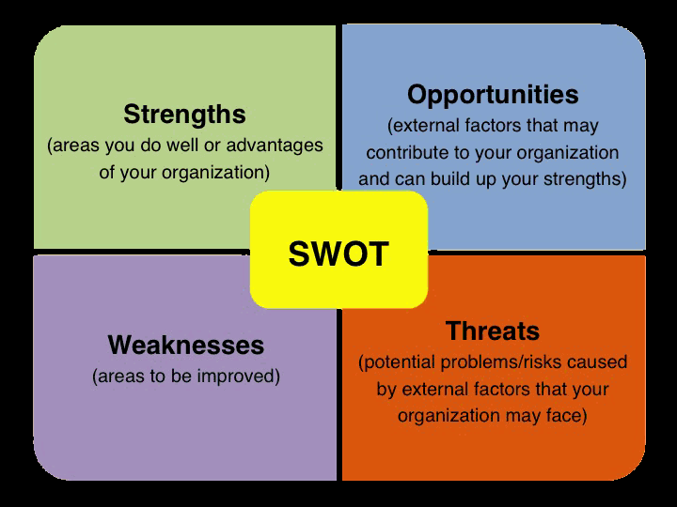
SWOT ANALYSIS

Slide 7
WHAT HAPPENS NEXT?
From the SWOT analysis, you now begin to build the actual strategic plan.
You will identify the key areas that are specific to your school. (Every school will have different key areas that are unique to their school.)
Begin to develop goals for each of the key areas. You will need short term and long term goals.
A plan is generally for 5 years – What can you do Year 1? Year 2? Year 3? etc…

Slide 8
EXAMPLES OF KEY AREAS
Catholic Identity
Loreto Sisters Legacy
Enrollment/Marketing and Development
Community Engagement
Revenue Generating Electives
Awards/Accreditation
Technology
Campus Revitalization/Safety
For each of these areas, a statement of strategic direction was developed. Goals and strategies for each area were identified to guide more specific action planning. The annual action plans provide a framework for ongoing accountability and ensure that the school manages its resources toward the realization of its vision over the next five years.

Slide 9
TAKE ACTION!
It’s not enough to write a goal down. You have to say HOW you will accomplish that goal and write an action plan for what you will do to reach that goal over the next 3, 4 or 5 years
For Example – let’s say your goal is to increase school safety
Year One – have assessment of security by police, safety, or security personnel (look within your own community)
Year Two – determine funds necessary to implement security needs at the school. Research grant opportunities to cover the expense. Gather list of school parents who can do repairs, install fences, etc…
Year Three – write grants, establish fundraiser to continue safety improvements (security system, cameras, etc…)

Slide 10
THINK YOU’RE DONE?
Once the plan is complete, you are NOT done!
Don’t put the plan on a shelf – all your hard work to build the plan now needs to be put into action!
Have a Strategic Plan member join your School Board meetings monthly, bi-monthly, quarterly to keep the plan moving forward. Accountability is KEY!
Strategic Plan representative works with Development/Advancement Office to keep plan updated regularly.

Slide 11
Make Strategic Planning A Habit
Get ready for the strategic plan process!
Articulate your mission and vision
Review your strategic position
Agree on priorities
Organize the plan
Identify next steps/actions
Roll out the plan
Hold everyone accountable
GOOD LUCK!

Slide 12
MY INFORMATION

